Slide 1

FTT (for dummies*!)
23-01-24
*and very smart beginners

Slide 2

Contents: Part 1 Understanding the shares equation
1. What is FTT?
2. What is an S-curve?
3. How to simulate an S-curve?
4. What are levelised costs?
5. How to calculate consumer preferences?
6. How to calculate technology substitutions?
7. How to solve the shares equation?
8. Hands on session: Solving a shares-like equation

Slide 3
Contents: Part 2
1. What is learning-by-doing?
2. How do we simulate learning-by-doing?
3. How does this affect consumer decisions?
4. A refresher on E3ME’s system of equations
5. Where does FTT fit in?
6. Integration of E3ME and FTT
7. Hands on session: Solving equations using Gauss-Seidel
8. Summary
Understanding important interactions

Slide 4
Key FTT definitions
Levelised cost: is a measure of the average net present value of a technology over its lifetime.
Net Present Value (NPV): In FTT, this is the sum of all relevant technology costs in a given year, multiplied by a discount factor. The discount factor ‘discounts’ the total technology cost back to the value it would have in the current year, based on a ‘discount rate’.
Discount rate: The discount rate is a positive number in FTT, which describes by how much ‘distant’ costs are reduced when considered at the ‘present’ time. It depreciates cash flows based on the assumed return the investor would acquire.
Lifetime (τ): How long a technology lasts.
Leadtime (t): How long it takes to build and install a new technology.
Market share (S): The number of a particular technology N, divided by the total number of available technologies in the same market, N_{tot}.
Learning rate: the rate at which the costs of technologies decline over time.
CAPEX: Capital expenditure, which is the cost of purchasing or investing in a new technology. Various costs can be included in CAPEX, such as the cost of materials, manufacturing, and installation.
OPEX: Operational expenditure, which is the cost of operating a technology. This can include fuel costs and labour costs.

Slide 5

Part 1: Understanding the shares equation

Slide 6
What is FTT?

Slide 7
What is FTT?
FTT stands for Future Technology Transformations
FTT is a framework developed by J-F Mercure which can be applied to several different models
These models simulate changes in the market for different technologies

Slide 8
What is FTT?
For example, in the power sector, FTT: Power can simulate the replacement of gas turbines with windfarms, given the appropriate inputs
These replacements are based on the costs of these technologies relative to one another in the eyes of investors or consumers

Slide 9
What is an S-curve?

Slide 10
S-shaped curves?
Nakicenovic, Technology Forecasting and Social Change (1986)
See also Grubler, Nakicenovic and Victor, Energy Policy (1999)

Slide 11
How to simulate an S-curve?

Slide 12
How to simulate an S-curve?
To simulate an S-curve, we need to simulate consumers choosing to adopt new technologies when older technologies reach the end of their lifetime.
To do this, we can make consumers compare technologies based on price.
If we know how many units of a technology (j) breakdown we can estimate the probability that consumers will choose a certain technology (i) to replace those units.
We call this probability ‘consumer preferences’: it will tell us the percentage of j breakdowns replaced by i:
$${∆N}_{j→i} ={\left[\begin{aligned}Consumer \\ preferences\end{aligned}\right]}_{ij}{\left[\begin{aligned}Fraction of breakdowns \\ belonging to j\end{aligned}\right]}_{j}{\left[\begin{aligned}No. of \\ breakdowns\end{aligned}\right]}_{tot}$$

Slide 13
How to simulate an S-curve?
There may be other constraints which prevent technology j being replaced by technology i.
For example, if i is a new technology, we may not be able to produce new units quickly enough to fully satisfy consumer preferences.
We can estimate this constraint by including the fraction of current production capacity belonging to technology i:
${∆N}_{j→i} ={\left[\begin{aligned}Fraction of prod. \\ capital belonging \\ to i\end{aligned}\right]}_{i}$ ${\left[\begin{aligned}Consumer \\ preferences\end{aligned}\right]}_{ij}{\left[\begin{aligned}Fraction of breakdowns \\ belonging to j\end{aligned}\right]}_{j}{\left[\begin{aligned}No. of \\ breakdowns\end{aligned}\right]}_{tot}$

Slide 14
How to simulate an S-curve?
What happens if no preferred technologies have the production capital required to replace technology j?
No substitutions will happen, which means broken down units of j are replaced with new units of j.
${∆N}_{j→i} ={\left[\begin{aligned}Fraction of prod. \\ capital belonging \\ to i\end{aligned}\right]}_{i}$ ${\left[\begin{aligned}Consumer \\ preferences\end{aligned}\right]}_{ij}{\left[\begin{aligned}Fraction of breakdowns \\ belonging to j\end{aligned}\right]}_{j}{\left[\begin{aligned}No. of \\ breakdowns\end{aligned}\right]}_{tot}$

Slide 15
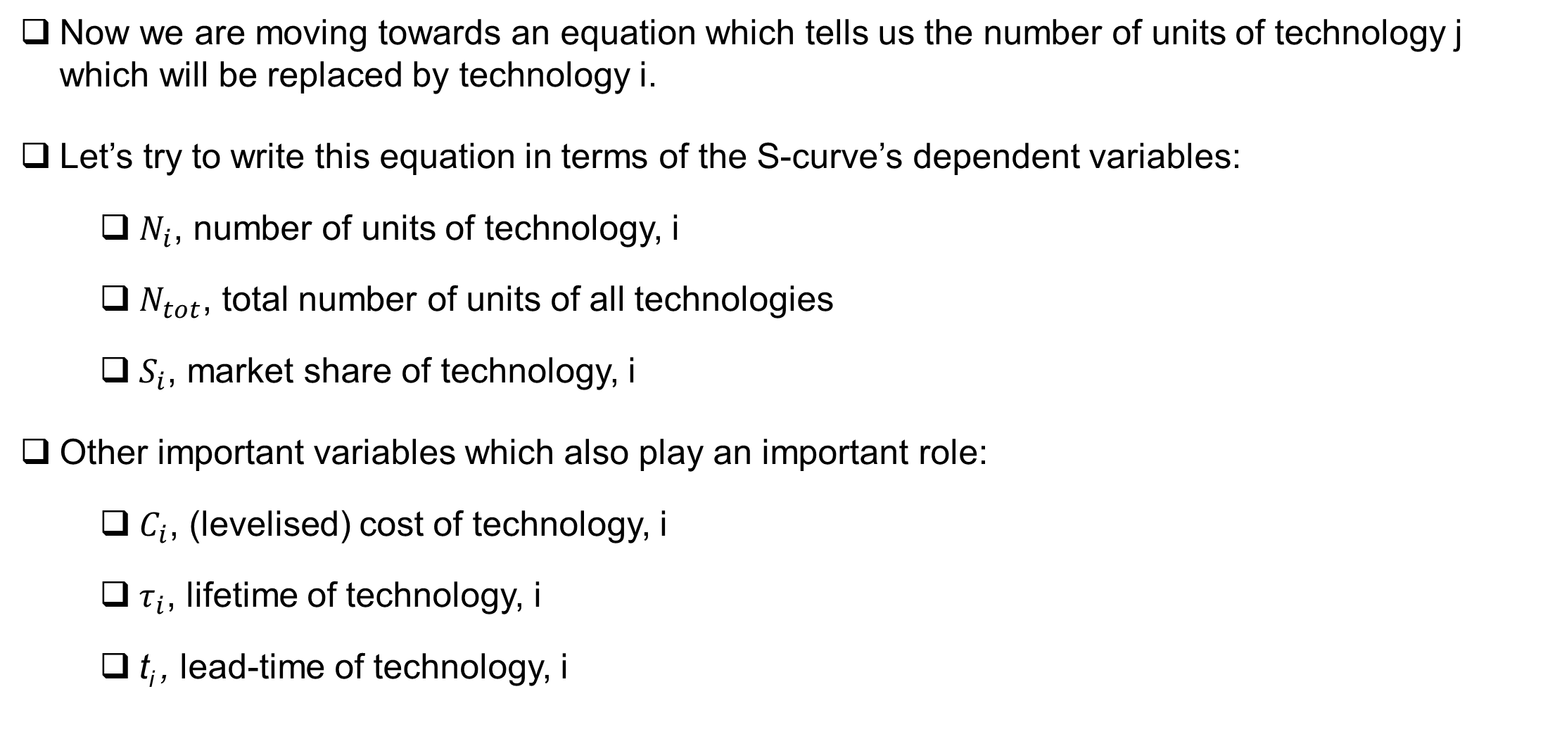
How to simulate an S-curve?
Now we are moving towards an equation which tells us the number of units of technology j which will be replaced by technology i.
Let’s try to write this equation in terms of the S-curve’s dependent variables:
$N_{i}$, number of units of technology, i
$N_{tot}$, total number of units of all technologies
$S_{i}$, market share of technology, i
Other important variables which also play an important role:
$C_{i}$, (levelised) cost of technology, i
$τ_{i}$, lifetime of technology, i
t_{i} , lead-time of technology, i

Slide 16
Estimating breakdowns
The last two terms in our equation simply equal the number of breakdowns of technology j:
$${\left[\begin{aligned}Fraction of breakdowns \\ belonging to j\end{aligned}\right]}_{j}{\left[\begin{aligned}No. of \\ breakdowns\end{aligned}\right]}_{tot}={\left[\begin{aligned}Breakdowns \\ of j\end{aligned}\right]}_{j}$$
We can estimate how many units of j breakdown in a year based on its average lifetime, τ.
For an existing amount of stock, the percentage of breakdowns in a single year will be approximately equal to 1/τ.

Slide 17
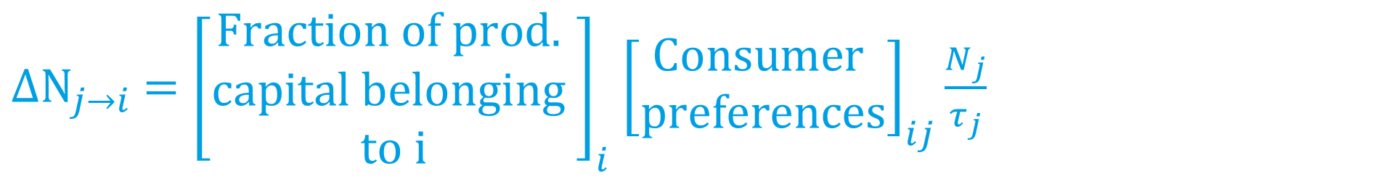
Estimating breakdowns
Hence, breakdowns of j in a single year are now represented by the number of units of j divided by the average lifetime of j in years:
${∆N}_{j→i} ={\left[\begin{aligned}Fraction of prod. \\ capital belonging \\ to i\end{aligned}\right]}_{i}$ ${\left[\begin{aligned}Consumer \\ preferences\end{aligned}\right]}_{ij}\frac{N_{j}}{τ_{j}}$

Slide 18
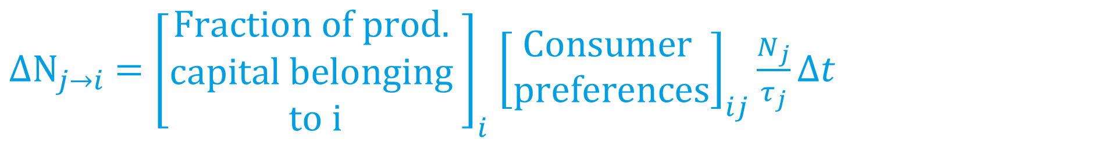
Estimating breakdowns
We can generalise this to any time period by multiplying by ∆t:
${∆N}_{j→i} ={\left[\begin{aligned}Fraction of prod. \\ capital belonging \\ to i\end{aligned}\right]}_{i}$ ${\left[\begin{aligned}Consumer \\ preferences\end{aligned}\right]}_{ij}\frac{N_{j}}{τ_{j}}Δt$

Slide 19
Estimating production capital
We can assume the available production capacity of a technology is proportional to the current number of units, N_{i}
If we multiply this by the fastest possible growth rate of production capacity, we can estimate the fraction of available production capacity at time t:
Here, t_{i} is the fastest possible timescale of growth, the inverse of which is the growth rate.
${∆N}_{j→i} =\frac{\overline{t}}{t_{i}}\frac{N_{i}}{N_{tot}}$ ${\left[\begin{aligned}Consumer \\ preferences\end{aligned}\right]}_{ij}\frac{N_{j}}{τ_{j}}Δt$

Slide 20
A function for consumer preferences
Consumer preferences in FTT are based on the probability that consumers perceive one technology as cheaper than another.
They can therefore be represented as a function, F, of the costs of the two technologies being compared:
The costs which consumer compare in FTT are known as levelised costs
${∆N}_{j→i} =S_{i}$ $F_{ij}(ΔC_{ij})\frac{\overline{t} N_{j}}{{t_{i}τ}_{j}}Δt$

Slide 21
What are levelised costs?
In FTT, we calculate the levelised cost of a technology by first calculating the unit cost to the consumer for each year of its lifetime.
In the first year, this will be the upfront investment unit cost.
In later years, these will be unit running costs such as OPEX and fuel costs.

Slide 22
What are levelised costs?

Slide 23
What are levelised costs?
These costs are discounted, depending on how far in the future they are.
This can be seen as taking the assumed return on investment of the consumer into account, minus interest payments for the initial investment,
or alternatively as an assumption that future costs are less important than present costs.
The discount rate encapsulates these factors, and is different in different FTT models.

Slide 24

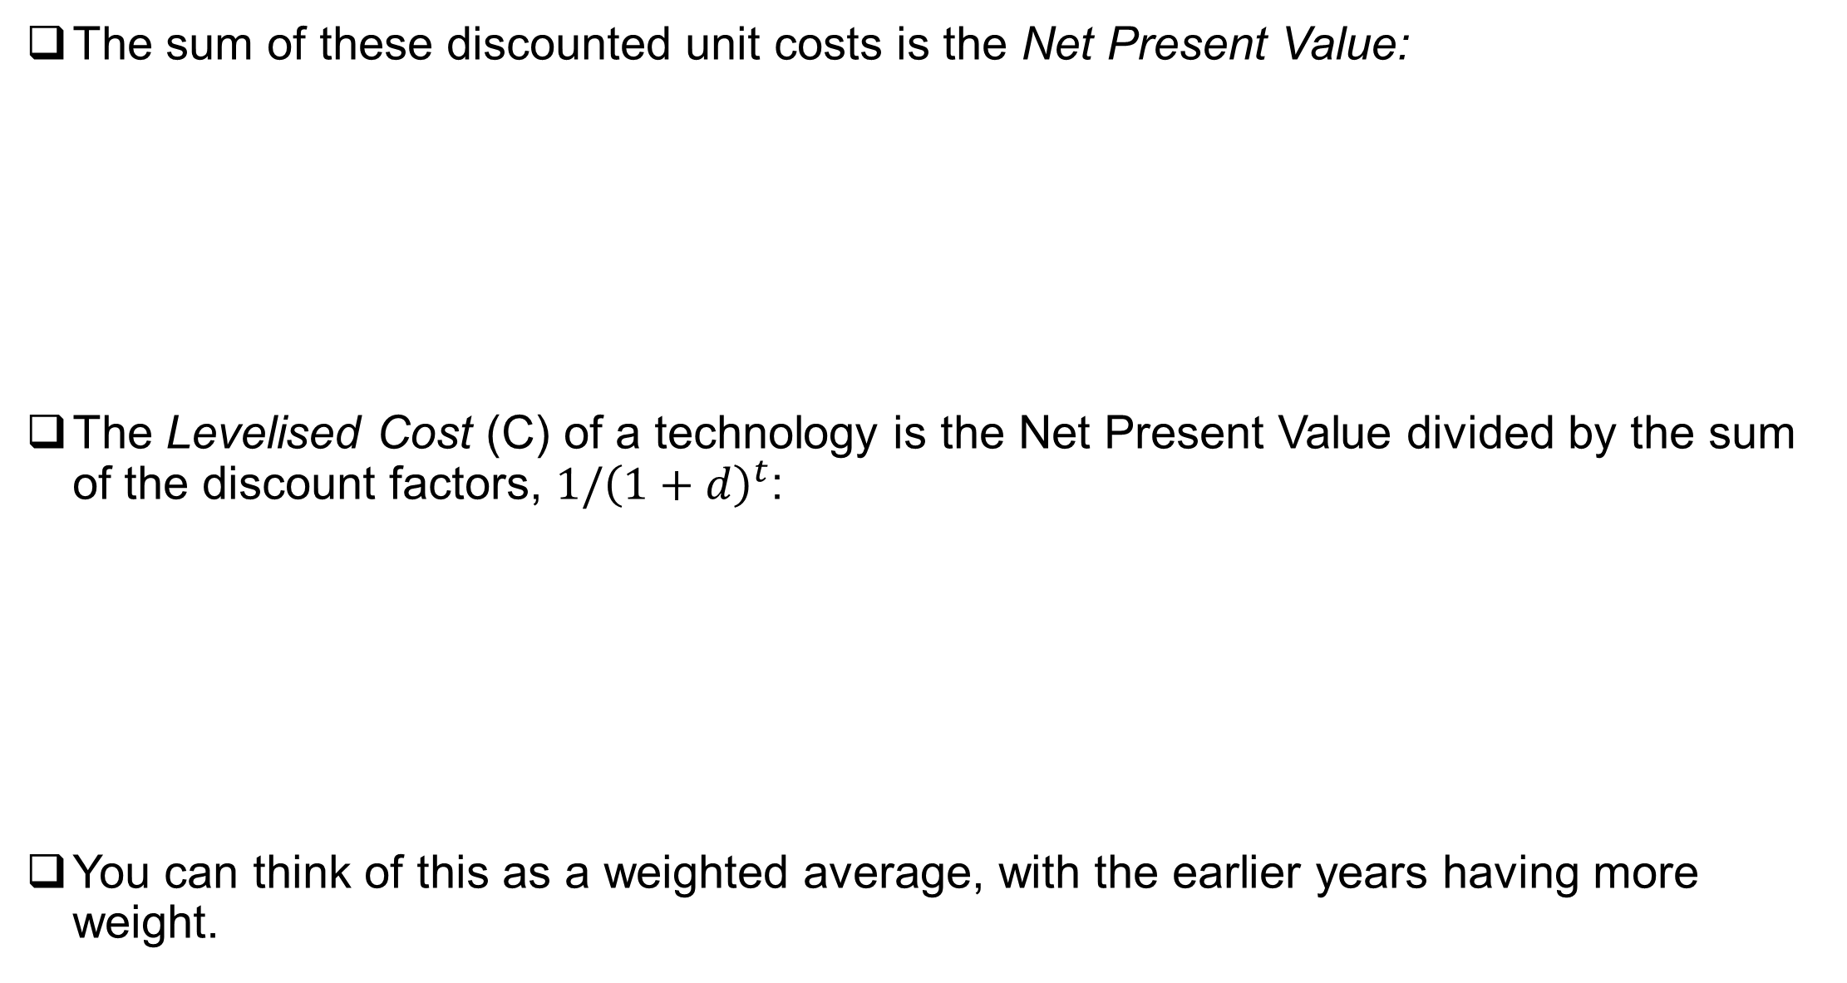

What are levelised costs?
The sum of these discounted unit costs is the Net Present Value:
The Levelised Cost (C) of a technology is the Net Present Value divided by the sum of the discount factors, $1/{\left(1+d\right)}^{t}$:
You can think of this as a weighted average, with the earlier years having more weight.
$$NPV=\sum_{t}{{(I}_{t}+{ O}_{t}+F_{t}) \frac{1}{{\left(1+d\right)}^{t}}}$$
$$C=\frac{NPV}{\sum_{t}{\frac{1}{{\left(1+d\right)}^{t} } }}$$

Slide 25
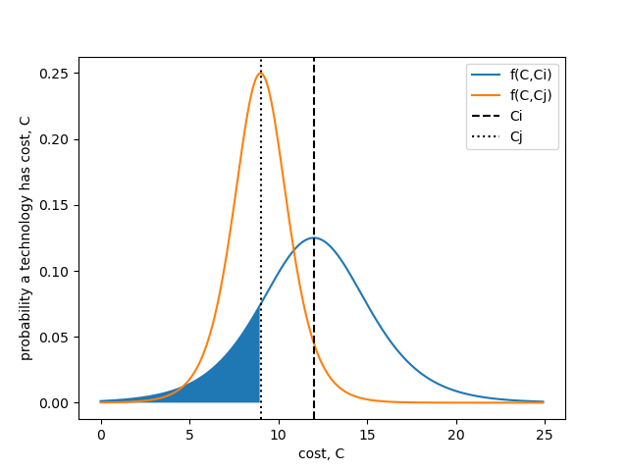
How to calculate consumer preferences?
For each technology, we can define a probability density distribution f(C,Ci) which tells us about the relative likelihood that a technology has a given cost, where Ci is the mean cost of that technology:

Slide 26
How to calculate consumer preferences?
When building a new unit of a technology, if we want to calculate the probability that it is less than a certain cost, Cj, then we need to add up all of the probabilities up to that point. As we are working with continuous distributions, the is equivalent to calculating the area under our distribution up to point Cj:

Slide 27
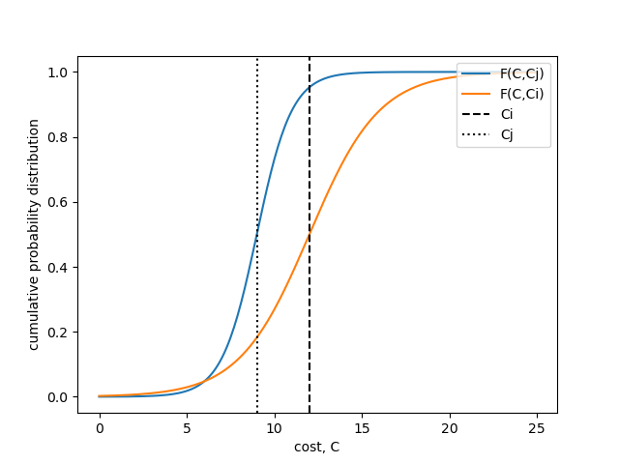
How to calculate consumer preferences?
We can calculate this area by integrating our probability distribution to find the cumulative probability distribution F(C, Ci). This will give us the probability that the new unit of technology i has a cost less than C.
Hence, the probability that a new unit of i will have a cost less than the median cost of technology j is F(Cj, Ci) or F(ΔCij), Fij for short.

Slide 28

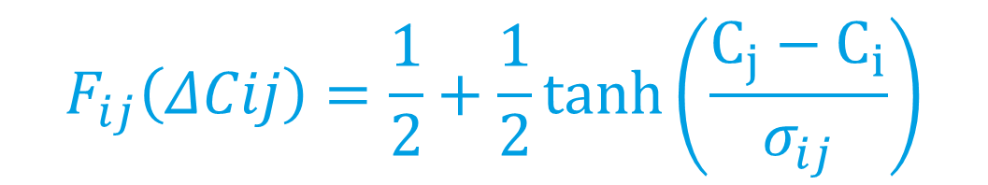


How to calculate consumer preferences?
$$F_{ij}\left(ΔCij\right)=\frac{1}{2}+\frac{1}{2}tanh\left(\frac{C_{j}−C_{i}}{σ_{ij}}\right)$$
$$F_{ij}\left(ΔCij\right)=\frac{1}{1+e^{ΔC_{ij}/σ_{ij}}}$$
$$σ_{ij}=\sqrt{σ_{i}^{2}+σ_{j}^{2}}$$
$$ΔC_{ij}=C_{i} −C_{j}$$

Slide 29
How to calculate technology substitutions?

Slide 30

How to calculate technology substitutions?
To estimate the overall change in technology i due to breakdown replacements of i and j alone, we need to calculate the net flow between i and j:
$${ΔN_{ij}=∆N}_{j→i}−ΔN_{i→j}$$
$$ΔN_{ij}=S_{i} F_{ij}\left(ΔC_{ij}\right)\frac{{\overline{t} N}_{j}}{{t_{i}τ}_{j}}Δt−S_{j} F_{ji}(ΔC_{ij})\frac{\overline{t} N_{i}}{{t_{i}τ}_{i}}Δt$$

Slide 31

How to calculate technology substitutions?
To estimate the overall change in technology i due to breakdown replacements of i and j alone, we need to calculate the net flow between i and j:
$${ΔS_{ij}=∆S}_{j→i}−ΔS_{i→j}$$
$$ΔS_{ij}=S_{i}S_{j}F_{ij}\left(ΔC_{ij}\right)\frac{\overline{t}}{{t_{i}τ}_{j}}Δt−S_{j}S_{i}F_{ji}(−ΔC_{ij})\frac{\overline{t}}{{t_{i}τ}_{i}}Δt$$

Slide 32
How to calculate technology substitutions?
To estimate the overall change in technology i due to breakdown replacements of i and j alone, we need to calculate the net flow between i and j:
$${ΔS_{ij}=∆S}_{j→i}−ΔS_{i→j}$$
$$ΔS_{ij}={(S}_{i}S_{j}F_{ij}A_{ij}−S_{j}S_{i}F_{ji}A_{ij})Δt$$

Slide 33
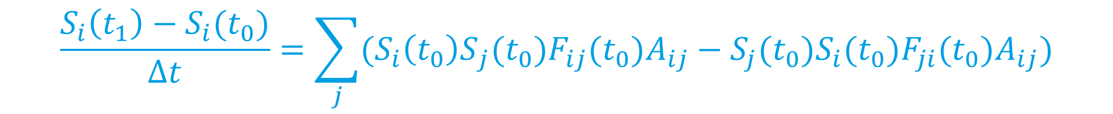

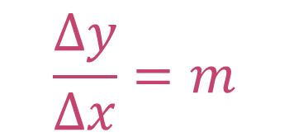
How to calculate technology substitutions?
The total change in Si can then be found by summing over j:
$$\frac{Δy}{Δx}=m$$
$$ΔS_{i}=\sum_{j}{{(S}_{i}S_{j}F_{ij}A_{ij}−S_{j}S_{i}F_{ji}A_{ij})Δt}$$
$$\frac{S_{i}\left(t_{1}\right)−S_{i}(t_{0})}{Δt}=\sum_{j}{{(S}_{i}{\left(t_{0}\right)S}_{j}(t_{0})F_{ij}(t_{0})A_{ij}−S_{j}{(t_{0})S}_{i}{(t_{0})F}_{ji}{(t_{0})A}_{ij})}$$

Slide 34
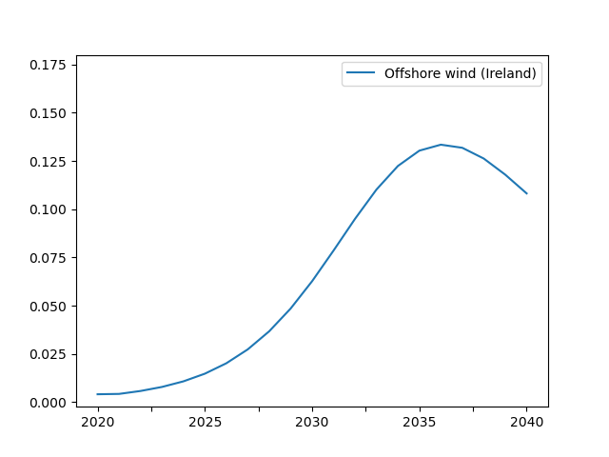

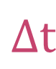
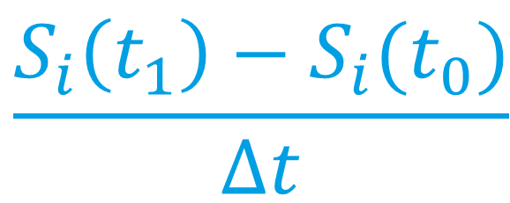
$$\frac{S_{i}\left(t_{1}\right)−S_{i}(t_{0})}{Δt}$$
$$ΔS$$
$$Δt$$

Slide 35

How to solve the shares equation?
Taking the limit to infinitesimal changes in S and t, we can find the following differential equation:
This is the shares equation!
$$\frac{dS_{i}}{dt}=\sum_{j}{{(S}_{i}S_{j}F_{ij}A_{ij}−S_{j}S_{i}F_{ji}A_{ij})}$$

Slide 36
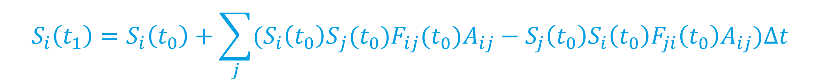
How to solve the shares equation?
We can solve this equation by taking very small steps in time
This ensures our tangents to the S curve are small, and a good approximation!
$$\frac{dS_{i}}{dt}=\sum_{j}{{(S}_{i}S_{j}F_{ij}A_{ij}−S_{j}S_{i}F_{ji}A_{ij})}$$
$$S_{i}\left(t_{1}\right)=S_{i}\left(t_{0}\right)+\sum_{j}{{(S}_{i}{\left(t_{0}\right)S}_{j}(t_{0})F_{ij}(t_{0})A_{ij}−S_{j}{\left(t_{0}\right)S}_{i}{\left(t_{0}\right)F}_{ji}{\left(t_{0}\right)A}_{ij})Δt}$$

Slide 37
Hands on session 1

Slide 38
Hands on session 1:
Solving a shares like equation
This method of taking small tangents to a curve to find its solution is known as the Euler method
It is a type of numerical integration
Use the Euler method to solve the following equation in python:
Plot the solution for y against the analytical solution
$$\frac{dy}{dx}=1/\cosh^{2}{x}$$
$$y_{0}=0, x_{0}=0$$

Slide 39

Hands on session 1:
Solving a shares like equation
$$y_{n+1}=y_{n}+\left(\frac{1}{{\cosh^{2}{x}}_{n}}\right)Δx$$
$$x_{n+1}=x_{n}+Δx$$
$$y_{0}=0, x_{0}=0$$

Slide 40
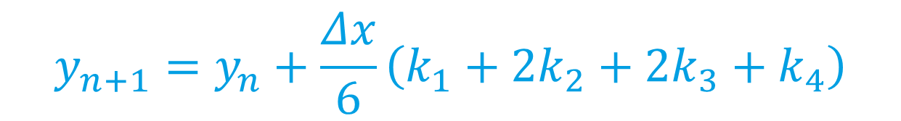




Runge Kutta:
Solving a shares like equation
RK4 is a more advanced algorithm, which will greatly reduce computational error in comparison to Euler:
$$k_{1}=f\left(y_{n}, x_{n}\right)$$
$$\frac{dy}{dt}=f\left(x\right), y\left(x_{0}\right)=y_{0}$$
$$k_{2}=f\left(y_{n}+\frac{Δxk_{1}}{2}, x_{n}+\frac{Δx}{2}\right)$$
$$y_{n+1}=y_{n}+\frac{Δx}{6}\left(k_{1}+2k_{2}+2k_{3}+k_{4}\right)$$
$$k_{3}=f\left(y_{n}+\frac{Δxk_{2}}{2}, x_{n}+\frac{Δx}{2}\right)$$
$$x_{n+1}=x_{n}+Δx$$
$$k_{4}=f\left(y_{n}+Δxk_{3}, x_{n}+Δx\right)$$

Slide 41
Part 2: Understanding important interactions

Slide 42
What is learning-by-doing?

Slide 43
What is learning-by-doing?
Learning-by-doing refers to the mechanism by which technologies become less expensive over time
The more we build and operate a technology, the better we get at this, which brings costs down

Slide 44

What is learning-by-doing?
The rate at which costs fall can be found from what is known as an experience curve
This curve has the following equation:
where C is the cost, W is the cumulative number of units of the technology, and b is the learning exponent.
$$C_{i}\left(t\right)=C_{i}\left(t_{0}\right){\left(\frac{W_{i}\left(t\right)}{W_{i}\left(t_{0}\right)}\right)}^{−b_{i}}$$

Slide 45

How do we simulate learning-by-doing?
If we take learning exponents from academic literature, we can use them to estimate the cost reduction of a technology based on its uptake in each FTT time step:
$$C_{i}\left(t\right)=C_{i}\left(t_{0}\right)−b_{i}C_{i}\frac{ΔW_{i}}{W_{i}}$$

Slide 46
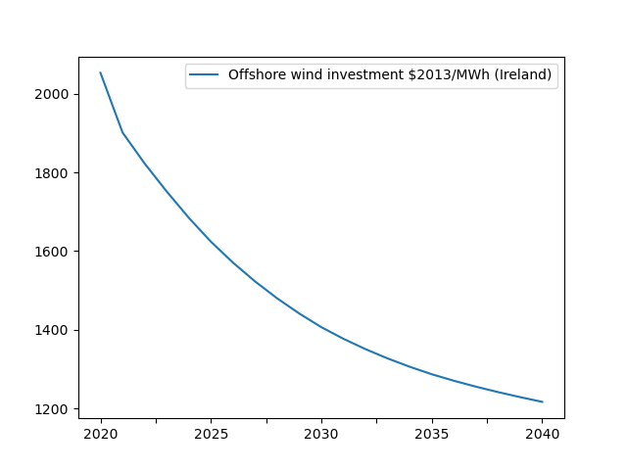
How do we simulate learning-by-doing?

Slide 47
How does this affect consumer decisions?
Costs of newer technologies will fall more rapidly as their presence in the market increases
This will increase the likelihood of consumers choosing them over other technologies
This in turn creates greater cost reductions

Slide 48
How does this affect consumer decisions?
These dynamic, reenforcing feedbacks are important as they can lead to tipping points
This is when new technologies out-compete traditional technologies based on cost alone

Slide 49
E3ME and FTT

Slide 50
How does E3ME solve?
E3ME is composed of two different types of equations:
Long run equations which describe long term trends in the economy… (UPDATE)
and short-run equations which handle short term shocks to the system (COMPUT)

Slide 51
How does E3ME solve?
E3ME’s short-run equations are a static, linear system of simultaneous equations
Each year, these equations are solved using a Gauss-Seidel-like routine, until a converged solution is found (or the maximum number of iterations is reached)
The model then moves to its updating phase, where the long-run equations are solved and the date is stepped forward in time
$$\overset{̿}{A}\overline{x}+\overline{b}=\overline{x}$$

Slide 52
Where does FTT fit in?
Unlike E3ME’s short-run equations, FTT is dynamic
Because of this, if we include it in E3ME’s iterative routine, it will not converge, unlike the other equations
It may also prevent E3ME’s other equations from converging!

Slide 53
Where does FTT fit in?
It will also have the consequence of ‘optimising’ consumer decisions, by continuously allowing them to remake their choices based on updated information
This goes against the spirit of FTT, where agents are designed to make imperfect decisions

Slide 54
Integration of FTT and E3ME
We can avoid these issues by solving FTT’s dynamical equations for shares and learning outside of E3ME’s iterative routine
We can allow consumers to make decisions based on a rough forecast of the year ahead, based on E3ME’s solution from the previous year
Once we have these results, we can use them as unchanging parameters in E3ME’s iterative routine

Slide 55
Hands on session 2

Slide 56
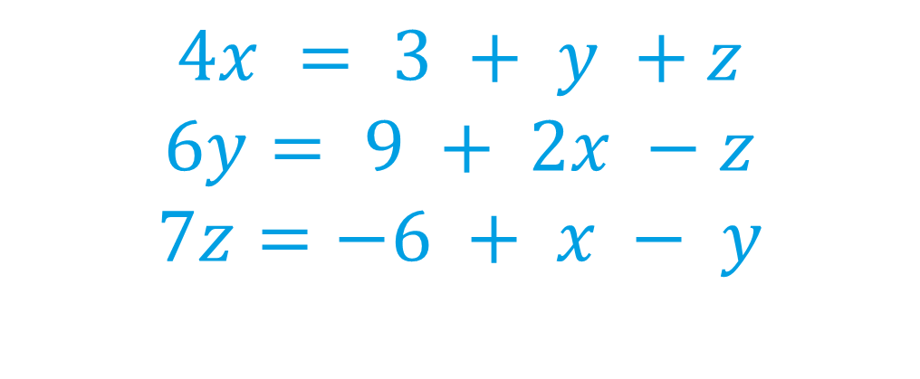
Hands on session 2:
Solving equations with Gauss-Seidel
The Gauss-Seidel method sequentially solves a system of linear equations, updating the values as they are computed
Solve the following set of simultaneous equations by writing a Gauss-Seidel function in python
Solve the same set of equations analytically and compare the results
Bonus for fun: if you do this by writing your own matrix inversion algorithm by the end of the day, I will buy you a small cake
$$4x = 3 + y +z$$
$$6y= 9 + 2x −z$$
$$7z=−6 + x − y$$

